Slide 2

“CHRISTENDOM”
“ECUMENICALISM”

Slide 3

Ecumenical Movement
What Is It?
How Has It Come About?
What Does It Involve?
What Are Its Consequences?
Is This The Form Of Ecumenicalism God Desires?
What Kind Of Unity Does God Want?

Slide 4
Ecumenicalism: nature and origins
Word Reference definition: “the doctrine of the ecumenical movement that promotes cooperation and better understanding among different religious denominations: aimed at universal Christian unity.”
“World Council of Churches” and “National Council of Churches” most obvious manifestations
Origins of Ecumenicalism –
  Missionary Societies of 19th Century
  Edinburgh Missionary Conference, 1910

Slide 5
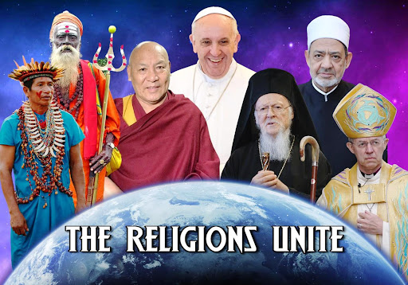
Who is involved in the movement?
Lutherans, Calvinists, Anglicans/Episcopalians, Roman Catholics, Eastern Orthodoxy, Disciples of Christ, etc..
Evangelical groups are opposed to the movement, while some others do participate

Slide 6
Ecumenicalism: tenets & consequences
Desire To “Respect” Differences Among Them
Promote What Is Called “Unity In Diversity”
Will agree to what are deemed the “essentials”
  Points of disagreement are not “essentials” and can be accepted and tolerated
  A movement of toleration of “Christian” differences with a veneer of unity
Consequences
  Any who disagree with concept labeled intolerant or divisive
  Feel they have established Bible unity – without changing doctrines or beliefs

Slide 7
What does the bible have to say?
Does the Bible agree with the idea of Ecumenicalism?
Galatians 3:28 “neither Jew nor Greek”
Romans Chapter 14
  Deals with matters of liberty or indifference
  Matters where God has no concern
  Romans 14:17 “righteousness, peace, and joy in the Holy Spirit" are not to be compromised!
Galatians 1:6-9 - Any different Gospel is ACCURSED!

Slide 8
What about the claims of the movement?
Does John Chapter 17 show the unity they have attempted to have?
John 17:1-23
  Vss 20-23 shows nature of unity – One as He and the Father are One!
Without Unity In Doctrine Cannot Really Be Unity
  Unified on “essentials” but whose definition?
  Their OWN!
  Not based on Scriptures but their own desires

Slide 9
Think about it:
Can anyone really say people who believe God has pre-determined who will be saved/ condemned and people who believe man has free will are either both right or distinction is not significant?
Can people believe in the pope’s authority and those who don’t, really say that such is not significant in the least?

Slide 10
1 Corinthians 1 testifies against them
1 Corinthians 1:10-13
Are these people really united in the “same mind and the same judgment?”
Without Unity In Doctrine Cannot Really Be Unity
  Why not some Cephas, some Paul, some Apollos, some Luther, some Wesley and some Calvin?
How can we be unified?
  John 17:20-23; 1 Corinthians 1:10-13
  True and Substantive Agreement!

Slide 11
What is the source of unity?
Not based on a list of “essentials”
Unity is based on GOD!
Ephesians 2:16 “reconcile them both to God in one body through the cross”
Colossians 1:20 “ by Him to reconcile all things to Himself”
Romans 1:16,17 “the gospel of Christ, for it is the power of God to salvation for everyone who believes”
Galatians 1:6-9

Slide 12
Must approach unity as obedient servants of our one master
NOT attempting to form coalitions and then trying to work out whatever differences exist!
Romans 14:3-13 – each responsible to ONE MASTER, first and foremost!
1 John 1:1-4 – IF we have fellowship with Apostles – our fellowship will include the Father and the Son!
Biblical unity exists when people who are one with the Father & Son are one with one another – John 17:20-23

Slide 13
Ecumenicalism today
Advocates ‘Unity In Diversity’
Bible allows diversity in matters of liberty – only!
Overall, the Bible demands God’s followers be one in MIND and JUDGEMENT – just as the Father and the Son are one!
Ecumenicalism is the attempt of denominations to have their cake and eat it too!
IN REALITY, THEY CAN HAVE NEITHER!

Slide 14

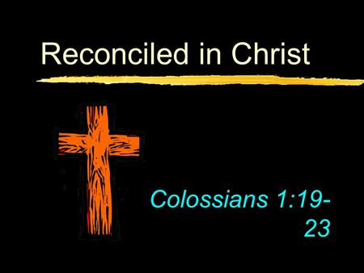
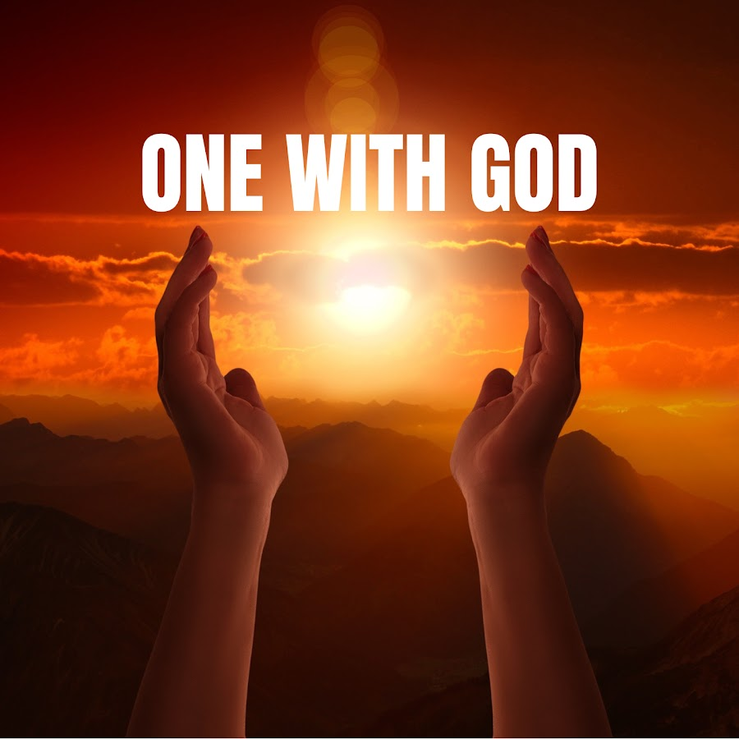
Unity flows from god
Bible Unity Flows From God
We have been reconciled through the blood of Christ
Unity comes from being ONE WITH GOD and therefore one with one another
UNITY

